Slide 1

Module: M2
Project: Chan–Vese Segmentation
Team:
Òscar Lorente Corominas
Antoni Rodriguez Villegas
Aditya Sangram Singh Rana

Slide 2
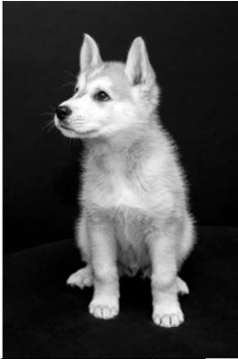
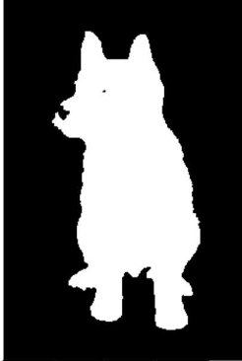
Task
Partition an Image into meaningful segments

Slide 3
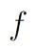
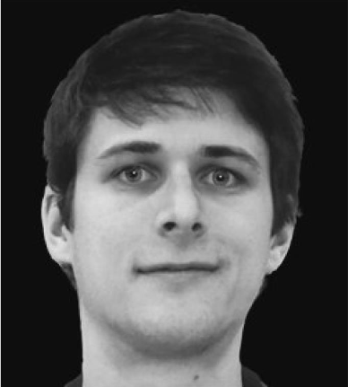
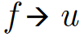
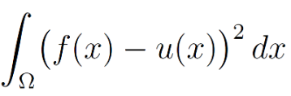
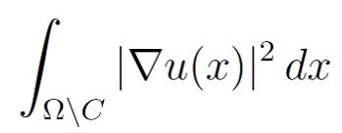

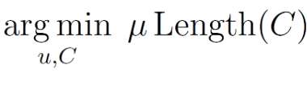
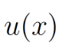
Method: Define Criterias
Mumford-Shah Solution
Criterion | Implication
Segmentation result is an image | Mapping in the same domain
Segmentation image is similar to the original image | Minimise
Segmented regions are homogeneous | Minimise
Segmented regions have smooth boundaries | Minimise
SOLVE

Slide 4

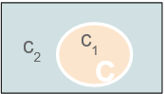
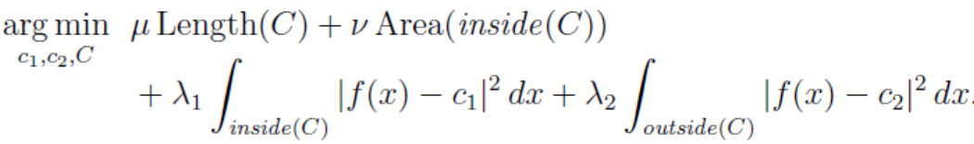
Method: Define Criterias
Chan-Vese Solution
Criterion | Implication
Segmentation result is an image | Mapping in the same domain
Segmentation image is similar to the original image | Minimise
Segmented regions are homogeneous | Minimise
Segmented regions have smooth boundaries | Minimise
Segmentation image has two regions | Constrain values
SOLVE

Slide 5
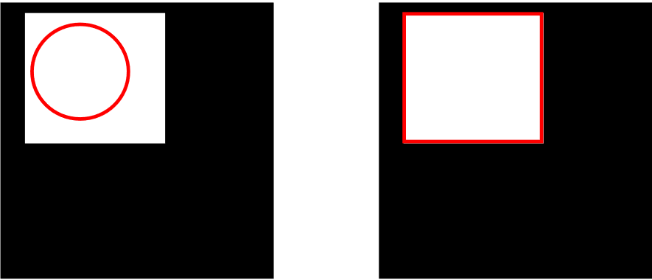
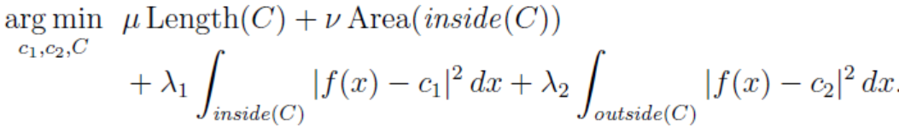

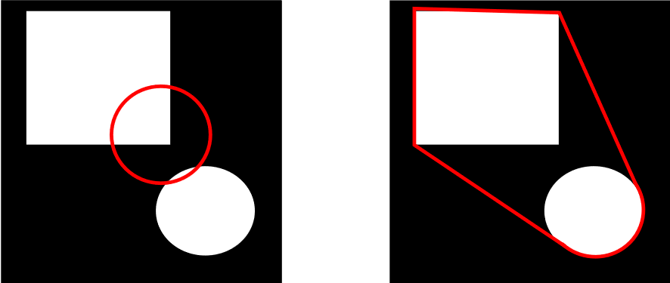

Limitation of Active Contours
Cannot take into account disconnected components

Slide 6
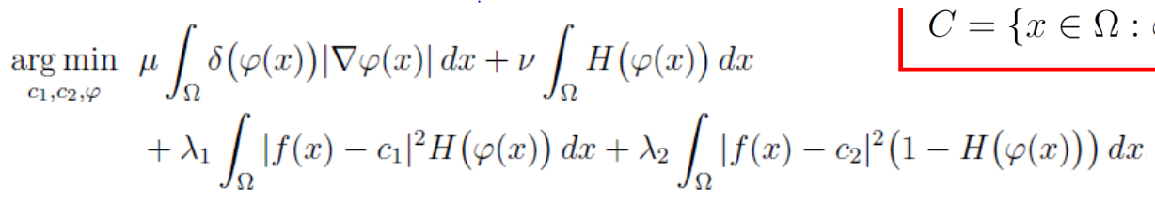
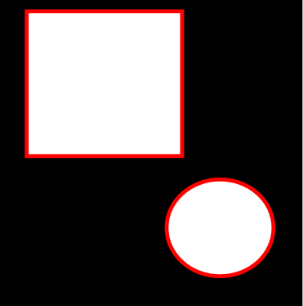
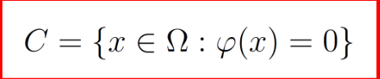
Solution: Active Surfaces
Can take into account any number of disconnected components.
φis a surface that intersects the image at the position of the red contour

Slide 7
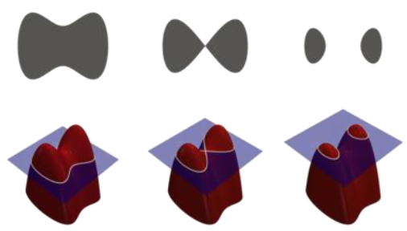
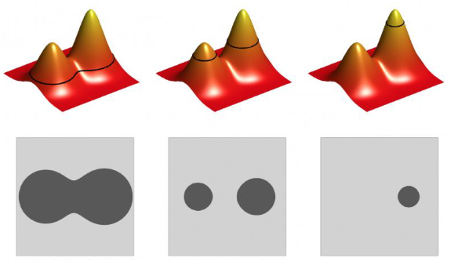
Solution: Active Surfaces
Can take into account any number of disconnected components

Slide 8
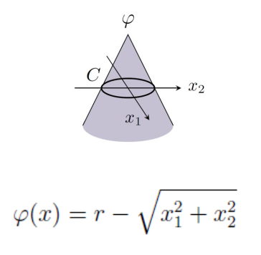
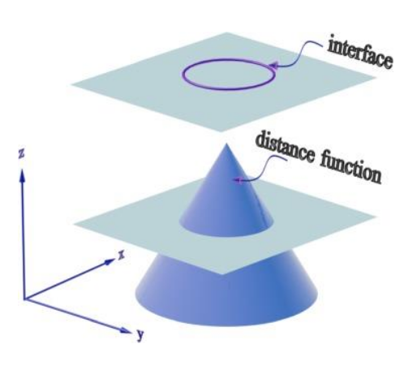
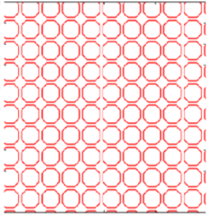
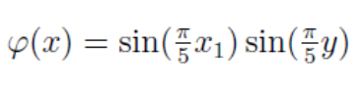
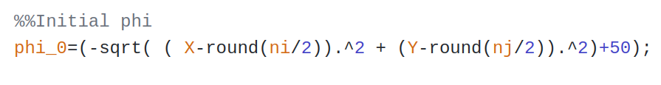
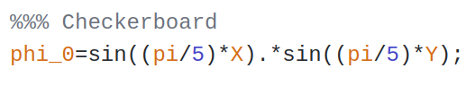
Code: Initial phi

Slide 9
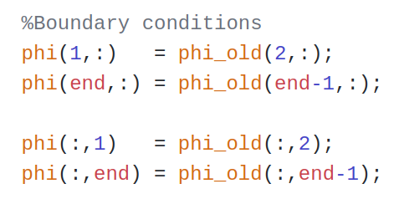
Code: Phi Boundary Conditions
The boundary condition is enforced by duplicating pixels near the borders

Slide 10
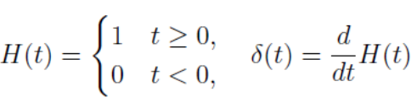
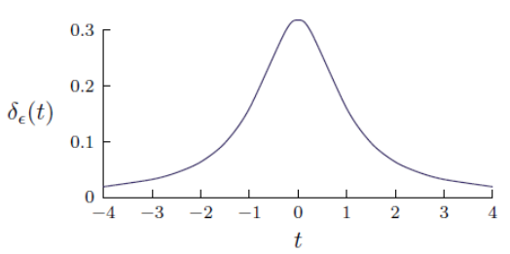
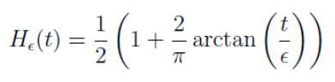
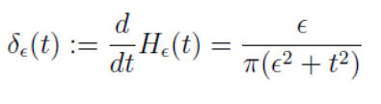
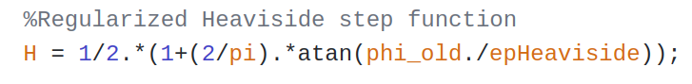
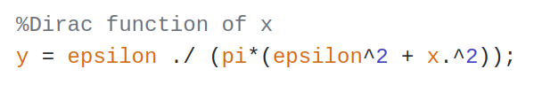
Code: Heaviside step function
Dirac
Regularized heaviside

Slide 11
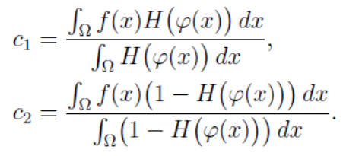
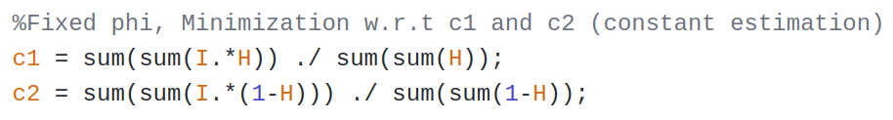
Code: c1 and c2
Average of the pixels intensity values inside each region

Slide 12
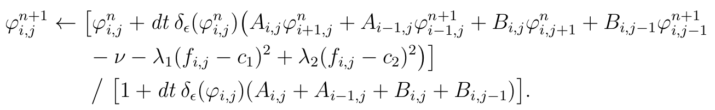
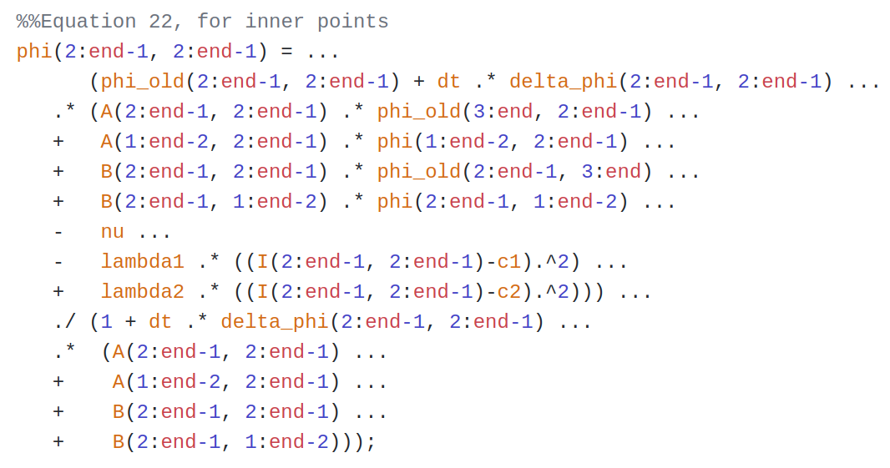
Code: Solving Chan-Vese minimization

Slide 13
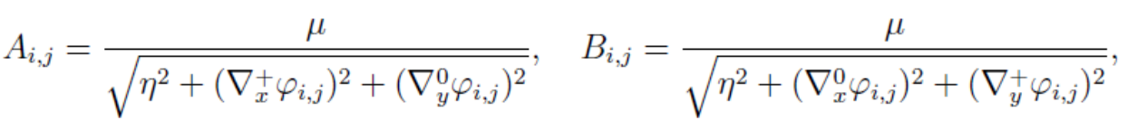
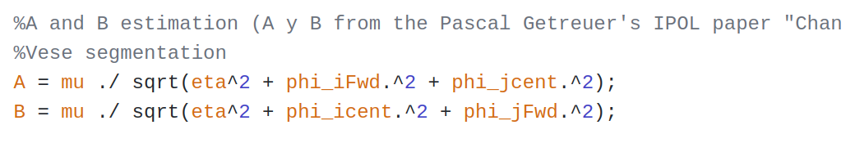
Code: Coefficients A and B (I)

Slide 14
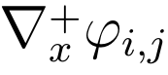
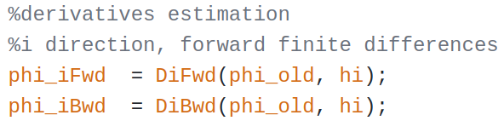
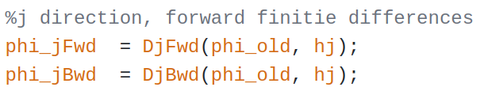
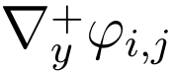
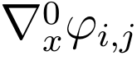
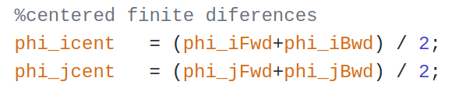
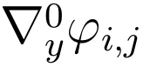
Code: Coefficients A and B (II)
Phi derivatives

Slide 15
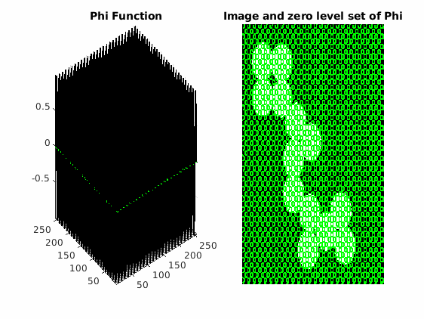
Results - Circles
The Chan-Vese approach yields good results when applied to images that have well defined homogeneous regions as shown below.

Slide 16
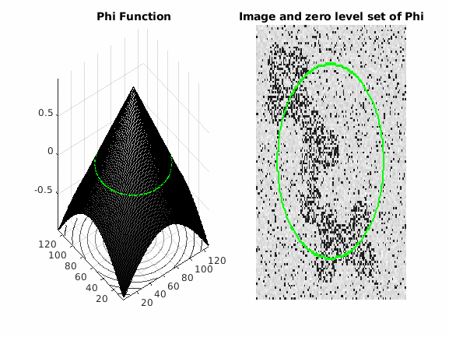
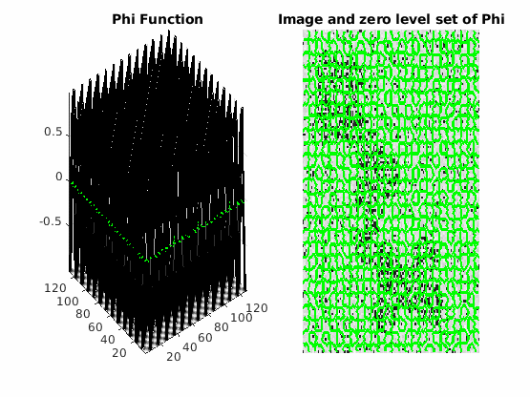
Results - Circles with Noise
The introduction of noise in the image produces worse results since it affects the distribution of pixels in the image, hence making the regions less homogeneous and the transition between c1 and c2 less clear.

Slide 17
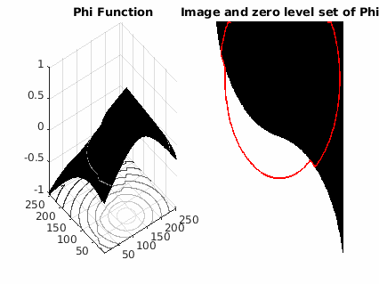
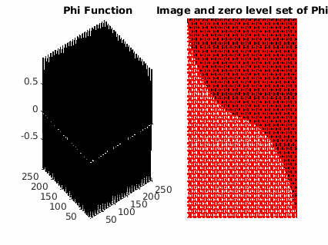
Results - Phantom 17
As stated in previous slides, images with well defined homogeneous binary regions yield good segmentation results. In this case we can observe how a checkerboard initialization results in a faster convergence.

Slide 18



Results - Phantom 18
Different values of mu for a noisy images will produce different outcomes: - In figure b) a phi with a checkerboard initialization and a small mu (which gives less importance to the length of the region contours) results in lots of undesired noise segmentation. - In figure c) the same initialization with a bigger mu value will give more importance to the length of the contours which lowers the effect of noise in the final segmentation. - Default initialization of phi (figure a)) with the same mu has shown to be less sensitive to noise.
(a)
(b)
(c)

Slide 19

Results - Hola Carola

Slide 20



Results - Custom image

Slide 21
Conclusions: Advantages
The model can be successfully applied to images with two regions which have a distinct mean of pixel intensity.
The model utilizes local image information efficiently
It has a simpliﬁed functional which is easier to minimize
The segmentation can be performed when there are no edges separating the regions since the algorithm works on pixel value proportions.

Slide 22
Conclusions: Limitations
The algorithm can only segment the images into two regions, since it works under the assumption that the edges (denoted by C) in the image can be represented by φ (C = {x ∊ Ω: φ(x) = 0}).
The Chan-Vesel approach is dependent on the initialisation of the level set function (φ) as the minimisation problem is non-convex.
To ensure fast convergence, the algorithm requires that the initial curve is close to the boundaries, otherwise the convergence is too slow.
For noisy images, too precise manual adaptation is required to reach convergence, which is not very useful in some applications.
In the Chan-Vese model, pixel intensities are assumed to be statistically homogenous in each region. As it assumes implicitly a Gaussian intensity distribution for each region Ωi, if the intensities with inside C or outside C are not homogenous, the constants c1 and c2 will not be accurate. In other words, the model generally fails to segment images with intensity inhomogeneity, which is often the case in medical imaging (especially in MR images where an intensity bias can be observed).

